Slide 1
Machine Learning Approach to Predictive Outcome for Sheltered Animals
Jasper Sandhu
SID: 862188200
University of California Riverside
UCR MSOL Data Science
12/03/2021
Notes:
Hello! I’m Jasper Sandhu and I will be presenting my capstone project, “Machine Learning Approach to Predictive Outcome for Sheltered Animals”.

Slide 2


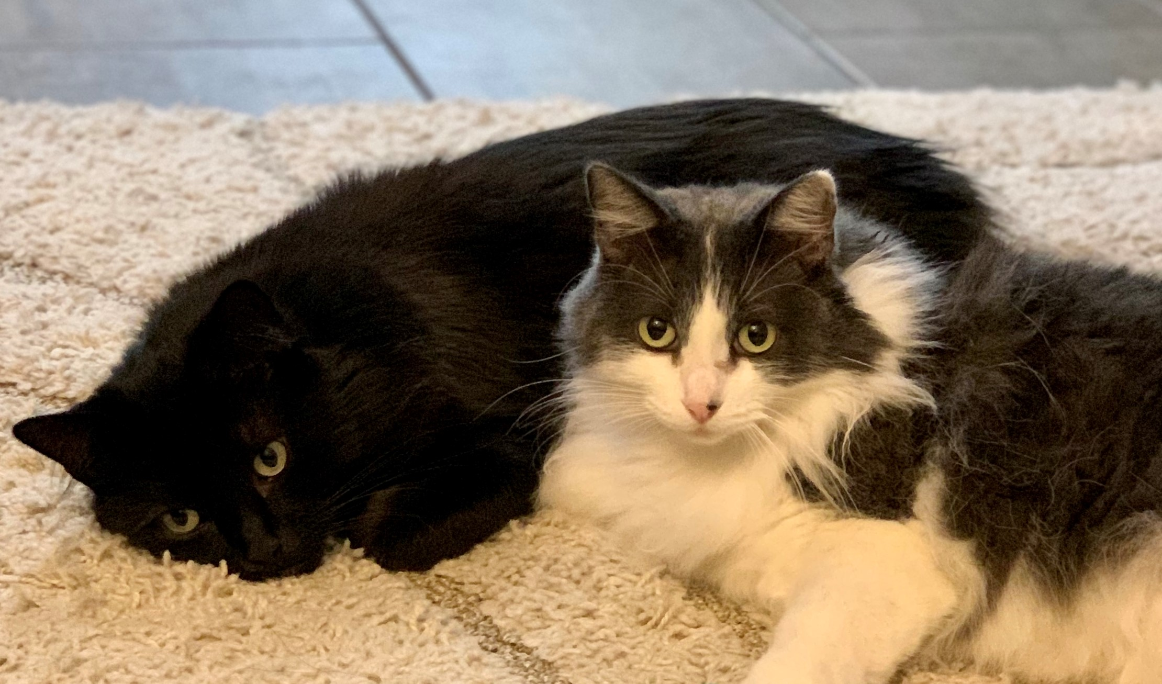
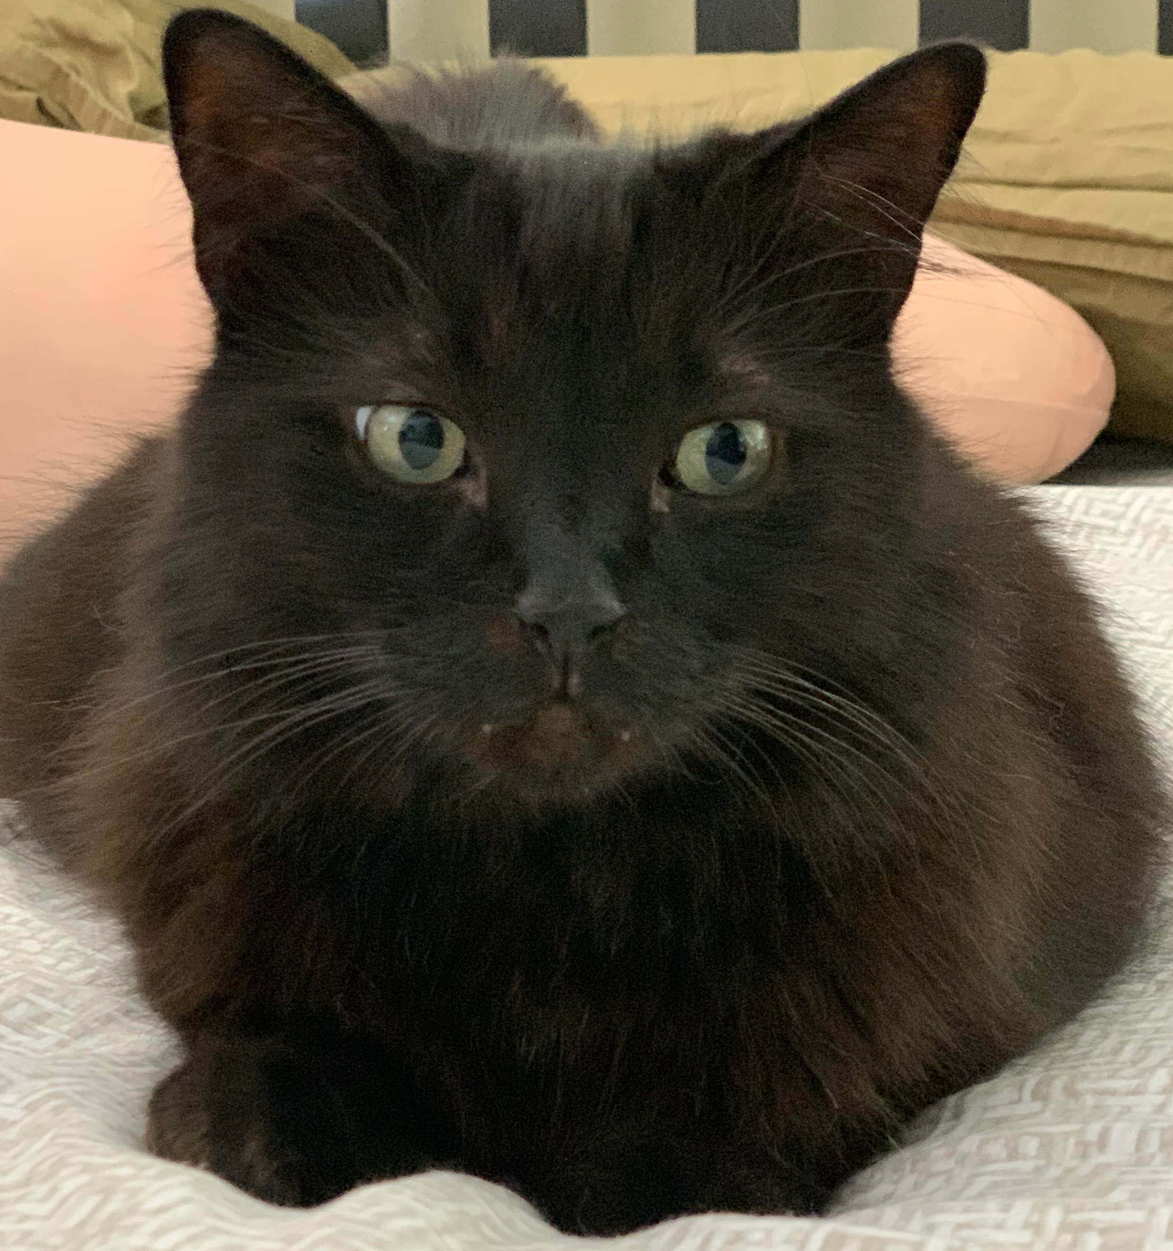
Background
MSOL, Engineering Data Science – UC Riverside
B.S. Electrical & Computer Engineering Technology- Cal Poly Pomona
Engineer at Raytheon Technologies
Coding, 3D Printing, R/C Heli’s & Drones, Electronic Projects
Proud owners of 2 adopted shelter cats (Pebbles & Shadowfang)
Notes:
Here’s a short background about myself. This is my final quarter enrolled in the MSOL Engineering Data Science program at UC Riverside. It’s been a pleasure pursuing my studies at the university and look forward to using it as a stepping stone to new adventures in my career. I completed my undergrad at Cal Poly Pomona in Electrical and Computer Engineering Technology.
I serve as an engineer for Raytheon Technologies, previously Collins Aerospace for over 16 years. Over those years I’ve worked as a test engineer, electrical engineer and now currently a manufacturing engineer. My initial motivation to pursuing a data science degree started while working on a government contract during my role as an electrical engineer. It was during 2019, we were working that contract bid which was competing against two other companies. One of the companies was L3 Communications and I don’t recall who the other company was partially due to the fact we didn’t consider them a threat during the competition. The project involved the use of laser-based technologies to detect chemical threats at the surface level and serve as a warning for other ground troops. I was involved with the system integration of personal and COTS based equipment while assisting our software group with the data training aspect. After just scratching the surface to what machine learning was about, I couldn’t help to dig deeper and eventually was motivated to pursue a degree in the data science field.
Outside of work I enjoy coding projects, 3d printing space, R/C Heli’s, Drones, Airplanes etc, and of course electronic projects in general.
Another motivation behind this study was my wife and I are strong believers in adopting animals who are in need of a home. The photos at the bottom of the slide are our two adopted Maine Coon cats, Pebbles adopted at 2 years of age, and Shadowfang at 5 years.

Slide 3
Overview
Over 6.5 million dogs and cats are placed in shelters each year.
1.5 million shelter animals are euthanized in the U.S. each year [1].
Shelters consist of Traditional & No-Kill facilities [2].
Physicians administering euthanasia adversely affected emotionally and psychologically by their experiences [3].
Austin Animal Center, known for being the largest no-kill shelter also maintains one of the largest active databases.
Notes:
I’ll now discuss the overview of the project.
In the United States, over 6.5 million dogs and cats are placed in animal shelters each year. While these shelters are temporary homes for these fortunate furry critters, there’s an offhand chance they could be euthanized, healthy or not if a permanent home isn’t found in time.
For the unfortunate pets unable to find a permanent home, each year approximately 1.5 million shelter animals are euthanized in the United States (670,000 dogs, and 860,000 cats) .
In the US there’s two types of shelters: traditional and no-kill establishments. Traditional shelters will euthanize animals depending on various circumstances while no-kill shelters will do their best to keep animals alive regardless of a overcrowding status of the facility.
With the help of a published data set maintained by Austin Animal Center, the largest no-kill animal shelter in the US, I will be investigating which characteristics have the highest correlation with successful adoptions. Further investigations will be performed to find additional correlations from the varying characteristics within the data.

Slide 4
Overview (cont.)
Using existing machine learning models, develop a useable tool for animal shelters determine if a pet is more likely adopted.
Benefits animal shelters by saving time and resources.
Development of the analysis tool consists of 2 phases:
Data Exploration -> Cleaning -> Feature Engineering -> Data Split
Compare the two machine learning models and analyze the results.
Notes:
Using some of the most widely used machine learning models, a predictive outcome methodology would be developed to compute the likelihood of an animal being adopted. This project will serve as a tool for animal centers to determine if additional emphasis should be spent on those animals who are less fortunate and could use additional attention to help influence a successful adoption.
Having this additional knowledge why animals with certain characteristics have greater difficulty finding homes could be helpful for animal shelters to place additional effort and time when marketing them. For example, what are the most attractive names of pets that seem to be adopted? And would giving an animal name such as “Pebbles” or “Cookie” entice lookers to research more about a prospective pet.
The general steps that will be processed to develop create the analytic tool that will help forecast the likelihood of adoption will consist of two phases. The first phase will involve data processing which consists of cleaning of the data, removing incomplete entries, feature engineering, and assigning numerical values to categorical data. The second phase will involve testing the data set with various machine learning algorithms such as random forest and logistic regression classifiers. After completing the second phase, further analysis will be made which involves comparison of false and true positive scoring before settling on a model. Having such tools developed will serve to benefit all types of animal shelters around the world and would not be exclusive to cats and dogs.

Slide 5
Significance
Could be utilized for other types of animals.
Reduced total euthanasia performed yearly.
Shorter shelter stays allows for additional animals in need of fostering.
Less strain on animal shelter staff
Serve as a basis for future research
Notes:
On this slide I’ll go over any additional significances.
Having such tools developed will serve to benefit all types of animal shelters around the world and would not be exclusive to cats and dogs.
Some of the obvious benefits include reduced animal shelter stays and less euthanasia’s performed.
Having shorter shelter stays would allow for additional rescues to be made to other unfortunate animals instead of otherwise be turned away due to overcrowding.
A byproduct of having less euthanasia’s performed in shelters, would be less of a burden that’s created on the staff who perform them.
While the idea behind this project has been explored before, re-visiting this with the latest advancements will yield an improvement in accuracy or at the least confirmation of previous findings, given the maturity of current machine learning models and larger data set. This project would pave the way for further advancements that could involve what states or locations have poor adoption rates and determine what the tradeoff is between adoption time versus relocating the animal to another shelter with higher adoption success.

Slide 6
Literature Survey
How Data Science Can Be Used to Improve Animal Shelter Outcomes (Andrews, 2018)
Determinants of Adoption and Euthanasia of Shelter Dogs Spayed or Neutered in the University of California Veterinary Student Surgery Program Compared to Other Shelter Dogs (Clevenger & Kass, 2003)
Prediction of adoption versus euthanasia among dogs and cats in a California animal shelter (Lepper et al., 2002)
Notes:
Previously there have been studies that looked at the correlation with the importance of names of the animals being kept in the animal shelter. The most common dog names were Max, Bella, and Daisy, while Ginger was the dog’s name that resulted in the most adoptions. Among cat names, Cookie was the clear winner (Andrews, 2018).
There have also been studies investigating positive benefits of neutering pre-adopted animals based on the probability of animal adoption (Clevenger & Kass, 2003). The study discussed the impact of the free sterilization services offered by veterinary medical schools and how it increased the chances of pet adoptions. The collaboration between both parties yielded an overall lower euthanization of adoptable pets.
Another related study was the prediction of adoption versus euthanasia among dogs and cats in a California animal shelter (Lepper et al., 2002). The final results of the study were that 26% of the dogs and 20% of the cats were adopted which was considerably lower than originally calculated. The takeaway from this study was there should be careful consideration for the availability of adoption before being considered an adoption candidate
Many of these studies conducted is based on relatively small data sets provided by handful of animal shelters around the United States. Having access to a considerably larger data set would be a way to solidify previous finding and find new information. For example, the Austin Shelter now has over 125,000 data points which is approximately four times larger than what many early studies used.

Slide 7
Methodology
What’s out there to get this project started?
Machine Learning model is only as good as the data fed into it.
Find a suitable data set that makes sense for the study.
Settled on the data set maintained by Austin based shelter.
Notes:
These next series of slides I’ll be going over the methodology behind the project.
With the understanding that the use of Machine Learning as a tool is only as good as the quality of data that is fed to into it. This set my first goal to search for an available data set before considering any web scraping techniques.
In my search for data, there were shelters with very detailed data sets that included as much as 23 features per animal such as how they were adopted, how long their stay was, and if it was a transfer. Unfortunately, as detailed as some of the data sets were, these sets had as few as ~10,000 rows of data points.
It wasn’t until coming across a shelter based out in Austin Texas that consistently updates and releases their shelter data for the last eight consecutive years. This gave promise that there exists a reasonable amount of data to generate accurate and predictable models for the project without too much difficulty. The animal shelter based in Austin provides shelter to ~18,000 animals per year and is known as one of the largest “No Kill Shelter”. The latest 2021 data available has approximately 125,000 data points in the data set. Having a large data set will be beneficial for achieving good model performance with the thousands of examples per class. Nonlinear classifiers such as random forest or logistic regression will benefit tremendously from this amount of data.

Slide 8
Methodology (cont.)
We’ve decided on the source of the data set, what’s next?
Data Exploration
Pre-processing & Cleaning of the Data
Feature Engineering
Data split into 70:20:10 (Training:Validation:Test)
Compare the scores of each classification used
Notes:
The first step to understanding the data is performing an exploratory data analysis to gain further understanding to the most obvious traits that impact adoption rates.
Before taking a peek at the data, the entire set will have to be pre-processed and cleaned up removing any anomalies or major data points that could skew the analysis.
Because we’re dealing with a relatively large data set, I would simply remove any of the anomalies such as missing labels and not attempt to artificially fill them. If there are a substantial number of rows with incomplete features, I will attempt to handle them accordingly with feature engineering techniques. The data will be looked at holistically before manipulating the data in segments. The step will be to analyze each animal by type e.g., cats and dogs. Within each type there’s multiple classifications for each animal that range from “Return to owner”, “Euthanasia”, “Adoption”, “Transfer”, and “Died”. All Categorical features as well as the Classification will be one hot encoded while numerical features will be scaled accordingly. A feature that will be carefully processed will be the “age upon outcome”, which currently has varying unit values in days, months, and years. This feature will be converted into days understanding that converting one-year or two-year values will have a coarse increment of 360 days to 720 days or etc. after it exceeds a year of measurement.
Data will be split into a 70% for Training, 20% for Validation, and 10% for Testing.
How well the models perform in regards to classification accuracy, Precision, Recall and F1 score, additional post processing may be performed such as re-visiting our “Feature Engineering” step which will be to add additional features such as coat patterns of the pet. For example, for dog breeds of type dalmatian, a description of “white spotted” would be added. The data simply lists the age of the animal by year and will need to create a feature that indicates if the animal is a kitten/puppy, adult or even elderly. Depending how well or poorly feature engineering is implemented, the newly created feature(s) may be thrown out to avoid adding complexity to the model and adversely affecting the analysis.

Slide 9
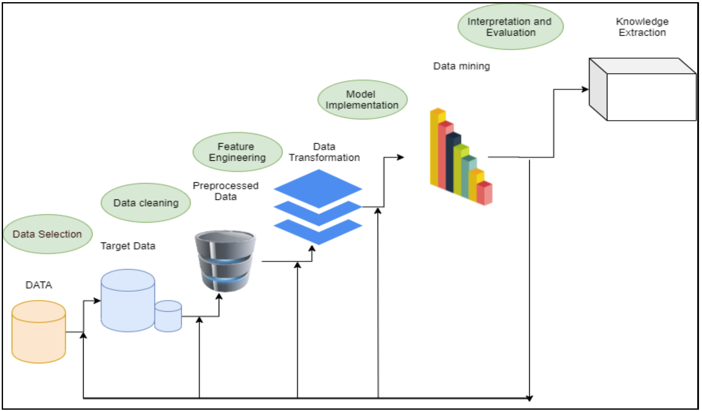
Methodology (cont.)
Chosen Classification Models:
Random Forest
Logistic Regression
Figure 1: KDD Methodology
Notes:
The first machine learning technique will be using is the Random Forest Classifier as it’s known to perform exceptionally well with a relatively large data set.
Attempting to generate the highest series of scores would be achieved by adjusting the various parameters such as “number of decision tree classifiers”, and “minimum amount of leaf nodes “.
Performing an analysis using a logistic regression classifier would also be performed and compared to the random forest algorithm used.
We will also attempt generate the highest series of scores will be made through hyper parameter tuning parameters of the logistic regression classifier.
Both models will be used to test for accuracy against the test set.
Depending on the results, the best model would be used toward creating a predictive program in determining adoption success rate.
Summarizing methodology steps will follow a general KDD methodology as seen in Figure 1.
The reasoning to staying consistent with a KDD methodology is at an abstract level, the KDD field’s primary focus is with the development of methods and techniques for making sense of data

Slide 10
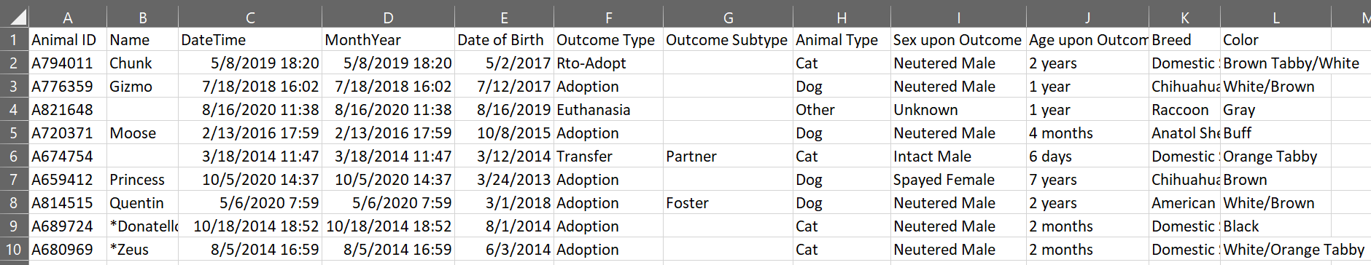
Methodology (cont.)
Data Collection
Sourced directly from Austin’s Animal Shelter Portal
More than 125,000 data points at the time of this study.
Figure 2: Austin Shelter Data Set
Notes:
This slide talks about the primary data set that was used.
We settled on the data set from Austin Animal Shelter due to how large the data set is.
While having over 125 thousand inputs with a time range from 2013 to 2021. The input data was very detailed with timestamped down to the hour of the day.
Figure 2 shows the raw data set that was imported directly from the Austin animal web portal.
Within the data set included features: animal id, name, datetime, monthyear, date of birth, outcome type, outcome subtype, animal type, sex upon outcome, age upon outcome, breed, and color.
The feature that we will consider the target output variable will be outcome type which included: adoption, died, disposal, missing, relocate, return to owner, return to adoption, as well as unwanted labels that would need further processing to clean up. All other features will be used in the classification training to build the machine learning model.

Slide 11
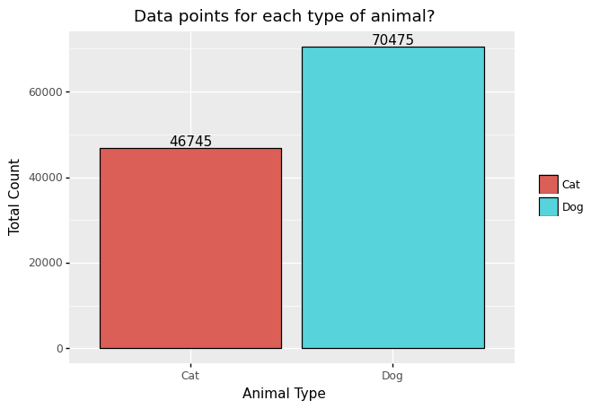
Methodology (cont.)
What’s left of the data after removing different types of animals outside the scope of the study.
Figure 3: Total Count for Cats & Dogs
Notes:
Before building up any models the first step was to analyze the raw data points in the data set to see what we were working with. Upon searching for all the unique animal types entered into the database we found the data base consisted of cats, dogs, bird, livestock and other animals. To minimize any data confusion and keep the scope of the project minimal all animals other than cats or dogs will be removed from the data set. Removing all the unwanted animal types from the data set trimmed our total entries of 125 thousand down to 117 thousand shelter inputs. The breakdown between cats and dogs can be seen in figure 2.

Slide 12
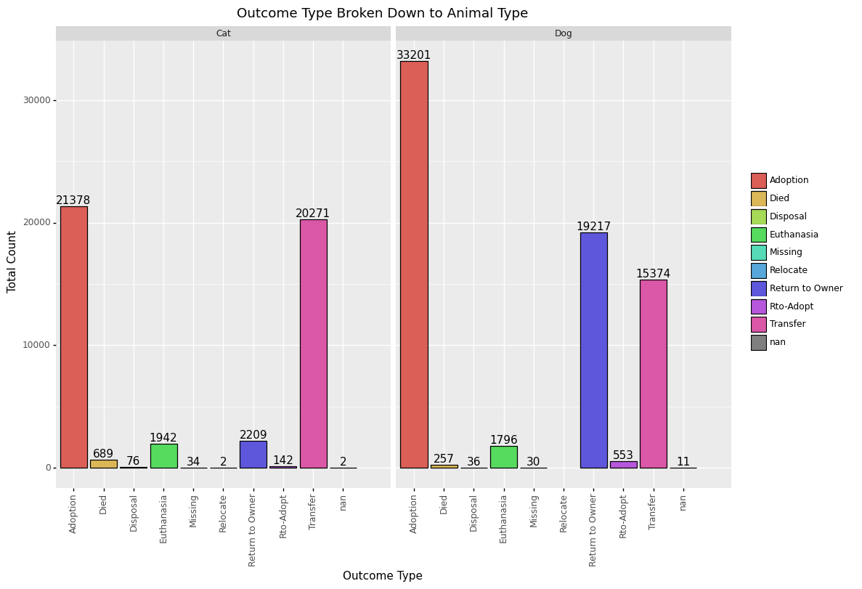
Methodology (cont.)
Separated by outcome type for each animal type.
Figure 4: Outcome Type Broken Down Between Animal
Notes:
Further steps were then made to understand the outcome types broken down within cats and dogs. Figure 4 shows the breakdown between each animal type and gives us insight that cats seemed to be Adopted less, with less chances of returning to owners and have higher shelter transfers. While dogs are the opposite with higher chance of adoption, higher return rate to owners with a lower ratio of transfers to that of cats.

Slide 13
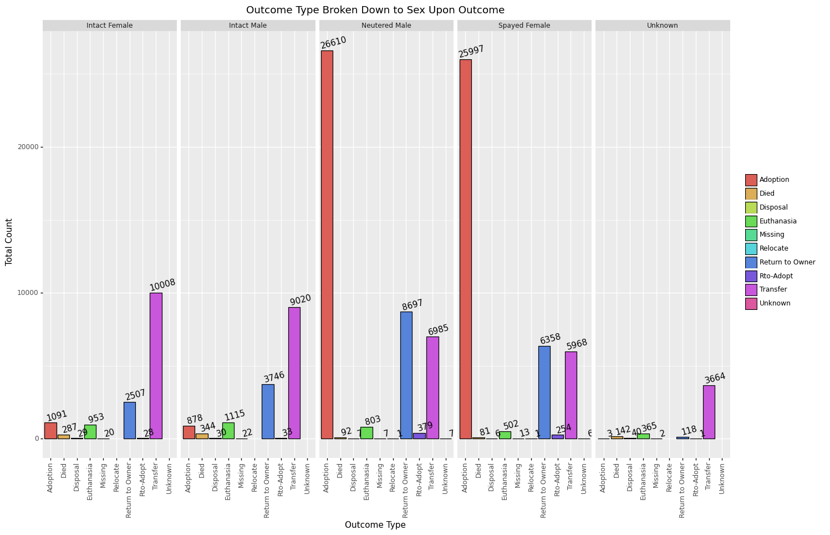
Methodology (cont.)
Separated by outcome type for each sex upon outcome.
Figure 5: Outcome Type Broken Down to Sex Upon Outcome
Notes:
We also explored outcome type broken down per sex upon outcome
Looking at figure 5, it’s seen that one of the major features that have a correlation to adoption rates is whether or not the animal is spayed or neutered. Unfortunately, this may be an example where correlation does not imply causation.
Further research found that a majority of states have implemented a mandatory spay and neuter law to help with the overpopulation of homeless animals (Hodges, 2010).

Slide 14
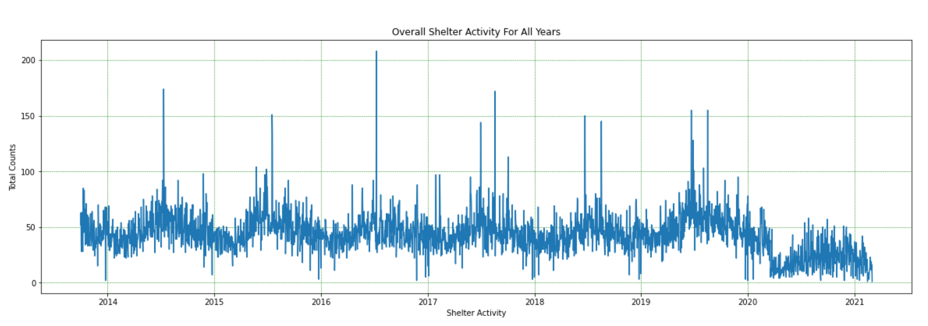
Methodology (cont.)
Shelter Data Activity
Figure 6: Overall Shelter Activity for All Years
Notes:
Using the date time feature which is also the for time of intake for each data entry it was possible to perform a time domain analysis on the overall shelter activity shown in figure 6.
From this we could see during the summer of every year activity slowly ramped up and spiked before settling down by the end of the year.
This gives us further insight that shelters are very overwhelmed during these periods of the year and could use any bit of help to reduce the strain.
An article pointed out that during the peak seasons of animal intakes is also the same time pet adoptions temporarily dip (Muñoz, 2019).

Slide 15
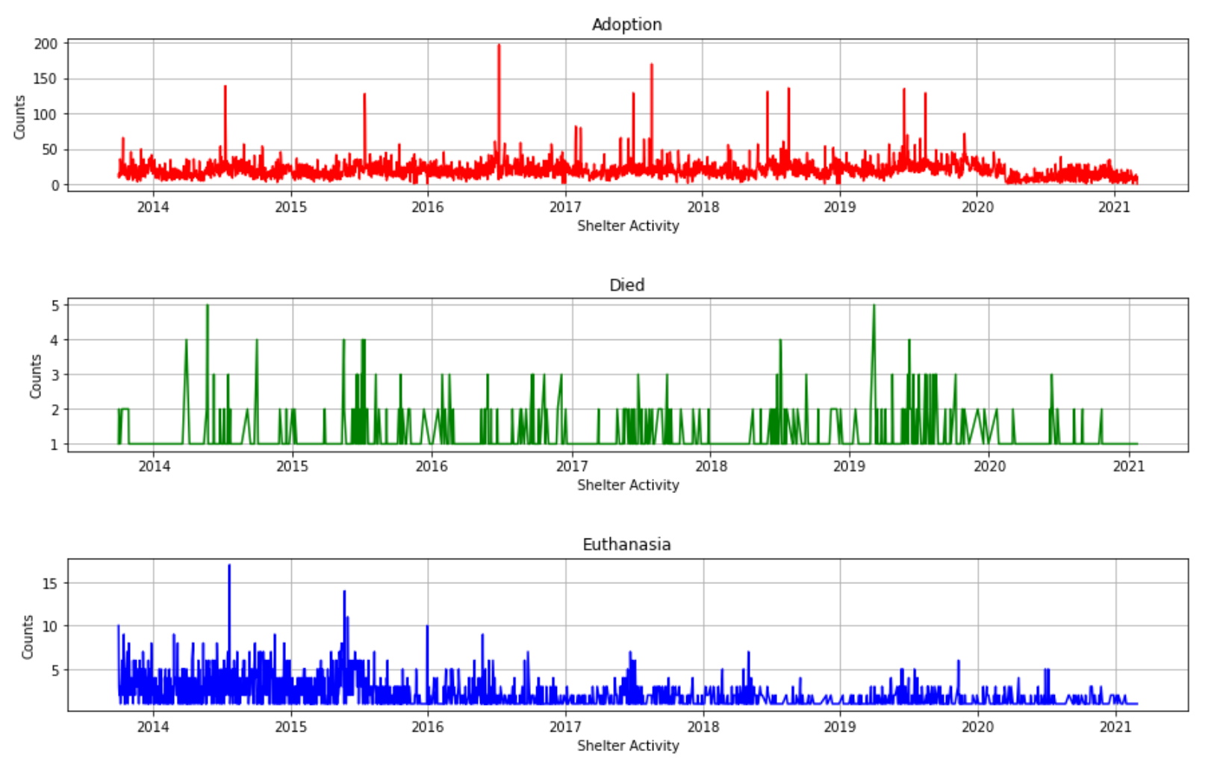
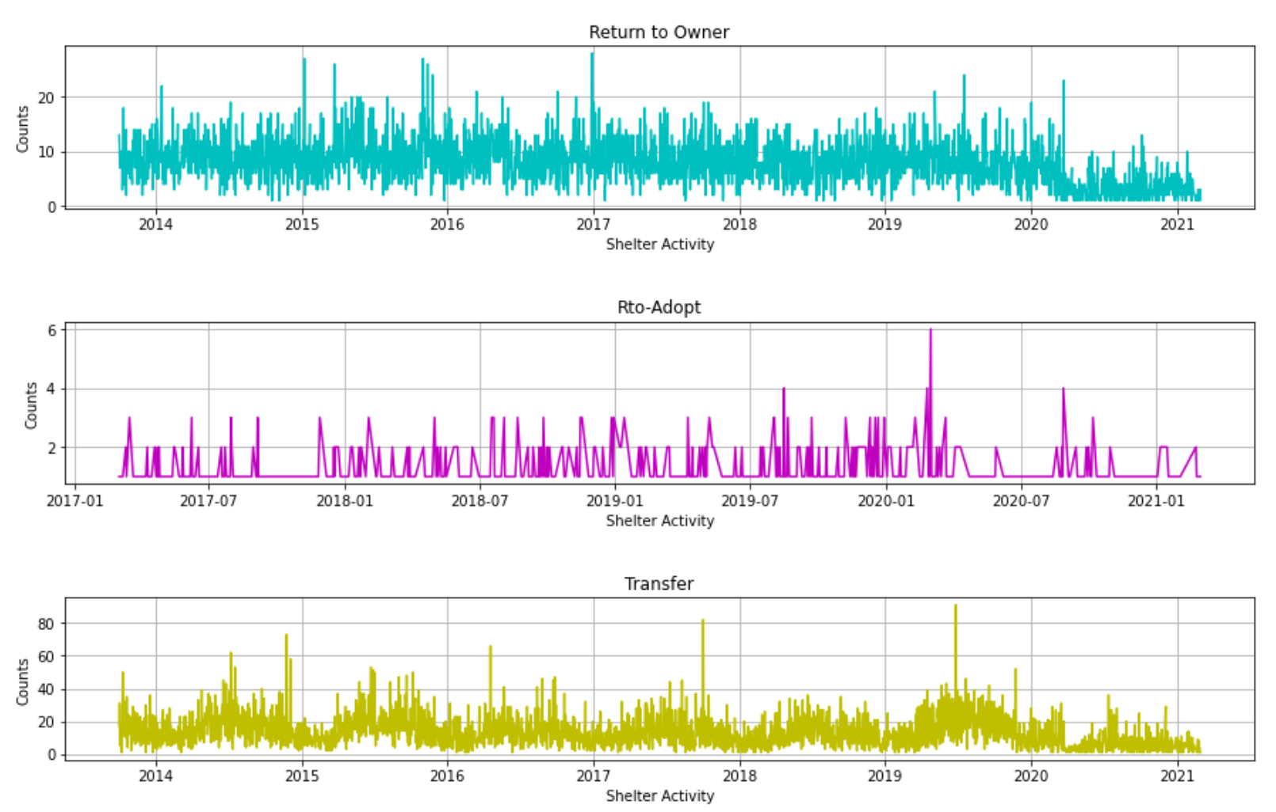
Methodology (cont.)
Shelter Activity Outcome per outcome (Day):
Adoption
Return to Owner
Adoption
Died
Euthanasia
Figure 7: Shelter Data Broken Down to Outcome Types (Days)
Notes:
Taking the overall shelter data and breaking it down into the possible outcomes: return to owner, return to adoption, transfer, adoption, died, euthanasia we can chart the data over time seen on figure 7.
In order to perform this step, all the data was merged into a single day before it was charted.
Judging from the data it seems that euthanasia’s performed gradually lessened throughout the years while animal adoption stayed consistent.

Slide 16
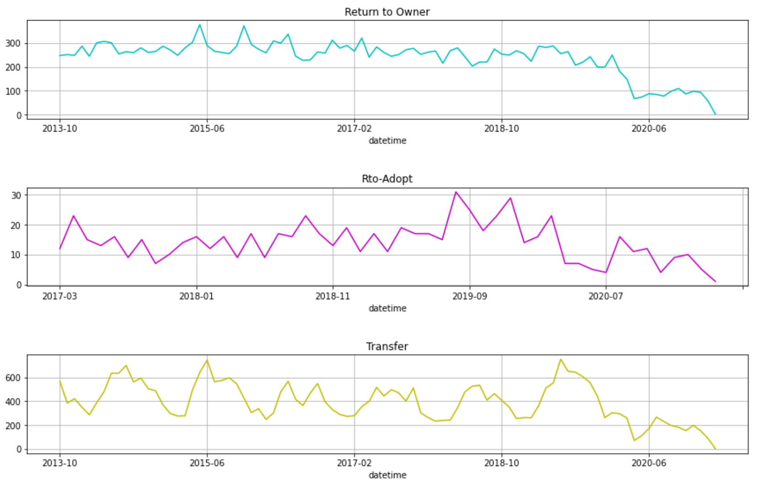
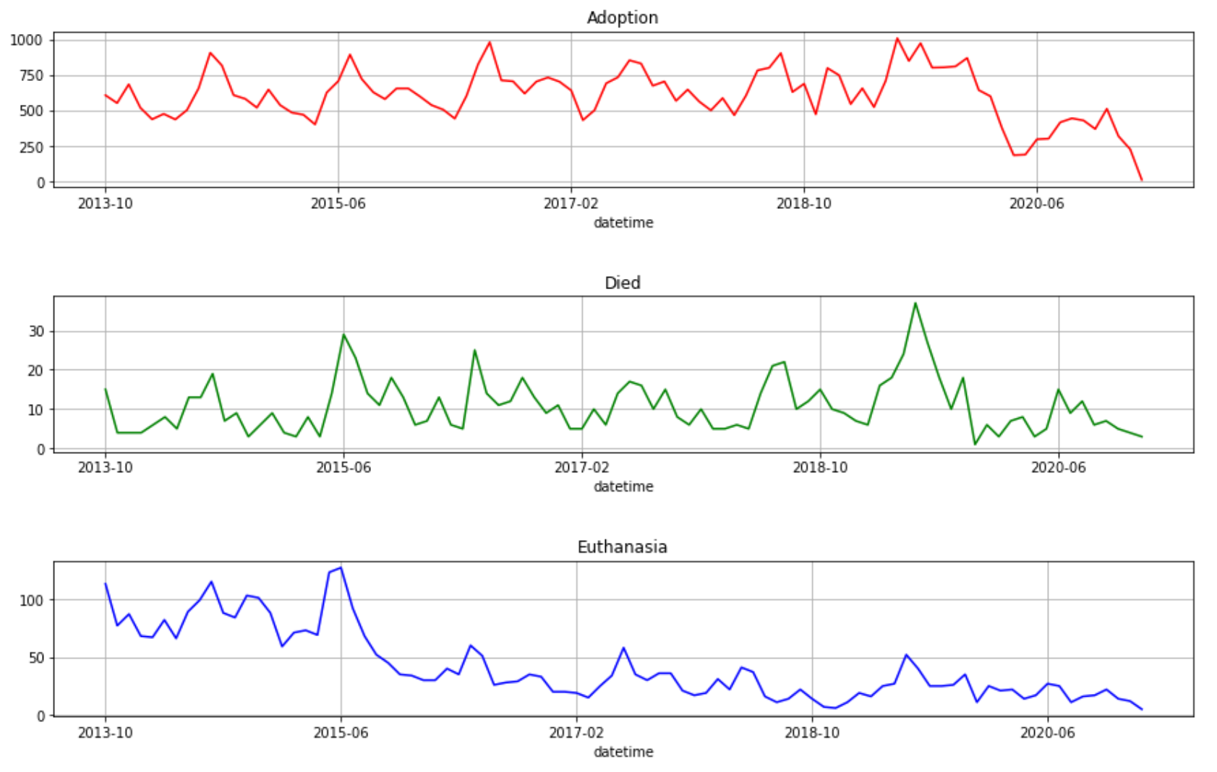
Methodology (cont.)
Shelter Activity Outcome per outcome (Month):
Adoption
Return to Owner
Adoption
Died
Euthanasia
Figure 8: Shelter Data Broken Down to Outcome Types (Months)
Notes:
To reduce any additional noise the data was further reduced by removing the individual days and simplify the time stamp to just contain month and year as shown in figure 8.
I was unable to deduce any information from the graphs that could assist with improving the model.

Slide 17
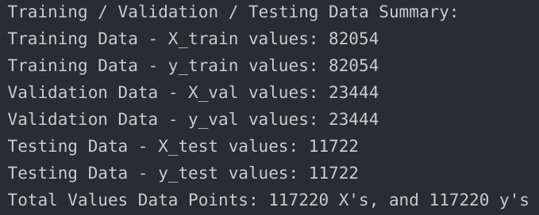
Methodology (cont.)
Feature Engineering Steps:
Simplify Date Time to Date Only
Simplify Age Feature
Label Encoding
Drop unnecessary features
Figure 9: Training/Validation/Training Data Breakdown
Notes:
Here we’ll go over the main feature engineering steps.
The original date time for each entry was not suitable to be used for training due to its complex format of day-month-year-hour-minute-seconds-am/pm format. A simple function reduced this down to a calendar day for all data points. Another issue that needed to be resolved was the varying units used for age upon outcome. Instead of using units of years, months, week, or days, a function was created to convert all animals to age in days.
Because we’re dealing with a large data set of categorical values, label encoding is used to convert them to numerical values in order for machine learning models to accept them as training input.
To remove as much noise from the model, features such as animal id, index, redundant features were removed.
At this point, the data was split into a 70:20:10 split of Training, Validation, and Test data. Figure 9 is the detailed breakdown after the data is processed through the split function.

Slide 18
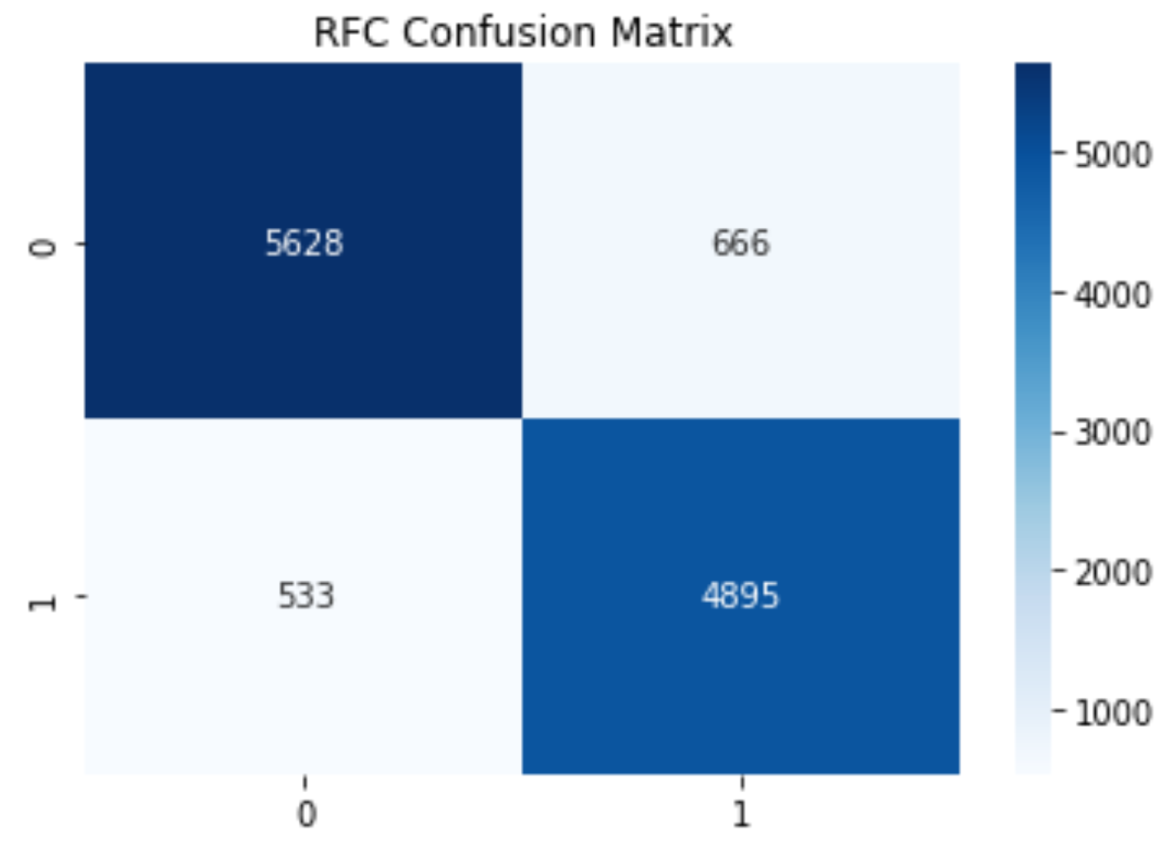
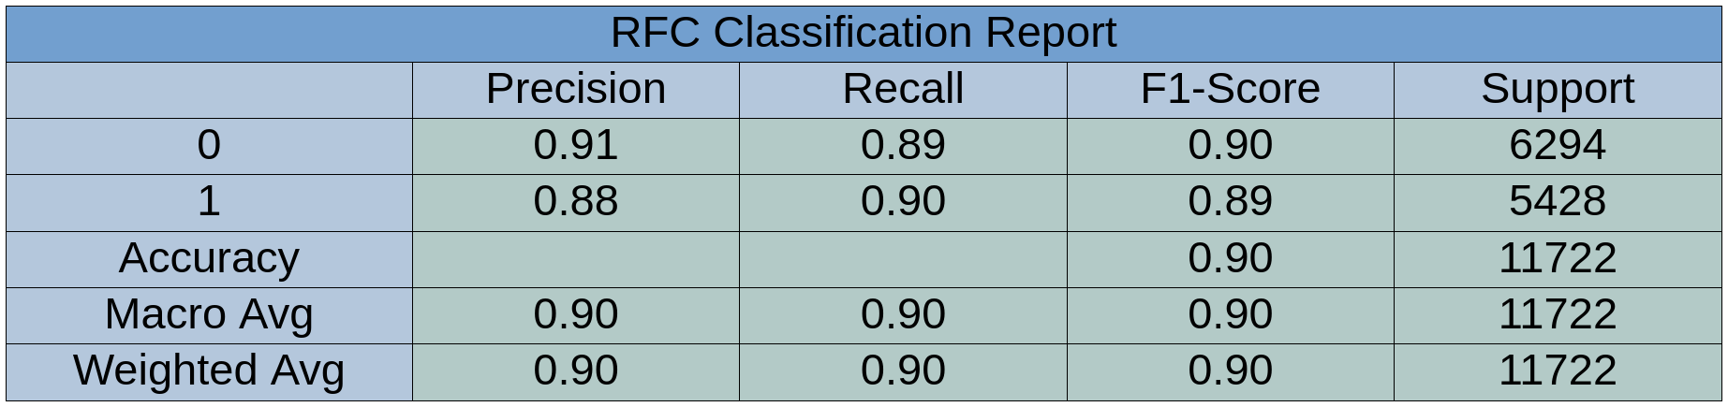
Results
Random Forest Results:
F1-Score was ~90%
Results show model is fairly accurate.
Figure 10: Random Forest Confusion Matrix
Figure 11: Random Forest Classification Report
Notes:
Gauging the performance of the model we scored for accuracy, precision, recall and f1 score each time the model was trained/fitted. Accuracy: is how many of the predictions were correct, Precision: out of all the truth predictions, how many were correct, and recall: is out of all the possible truths, how many were correct.
Closer attention is given to the F1-score which is a combination of both precision and recall to ultimately measure the accuracy of the model (Riggio, 2019).
The results from the random forest classifier are shown in figures 10 and 11. True negative of 5628 versus it’s False negative of 533 gave us an accuracy score of 91%.
While True positive was 4895 with a false positive of 666 yielded an accuracy of 88%. Precision, Recall and F1-Score averaged out to be approximately 90% which is surprisingly accurate in predicting the success of adoption.

Slide 19
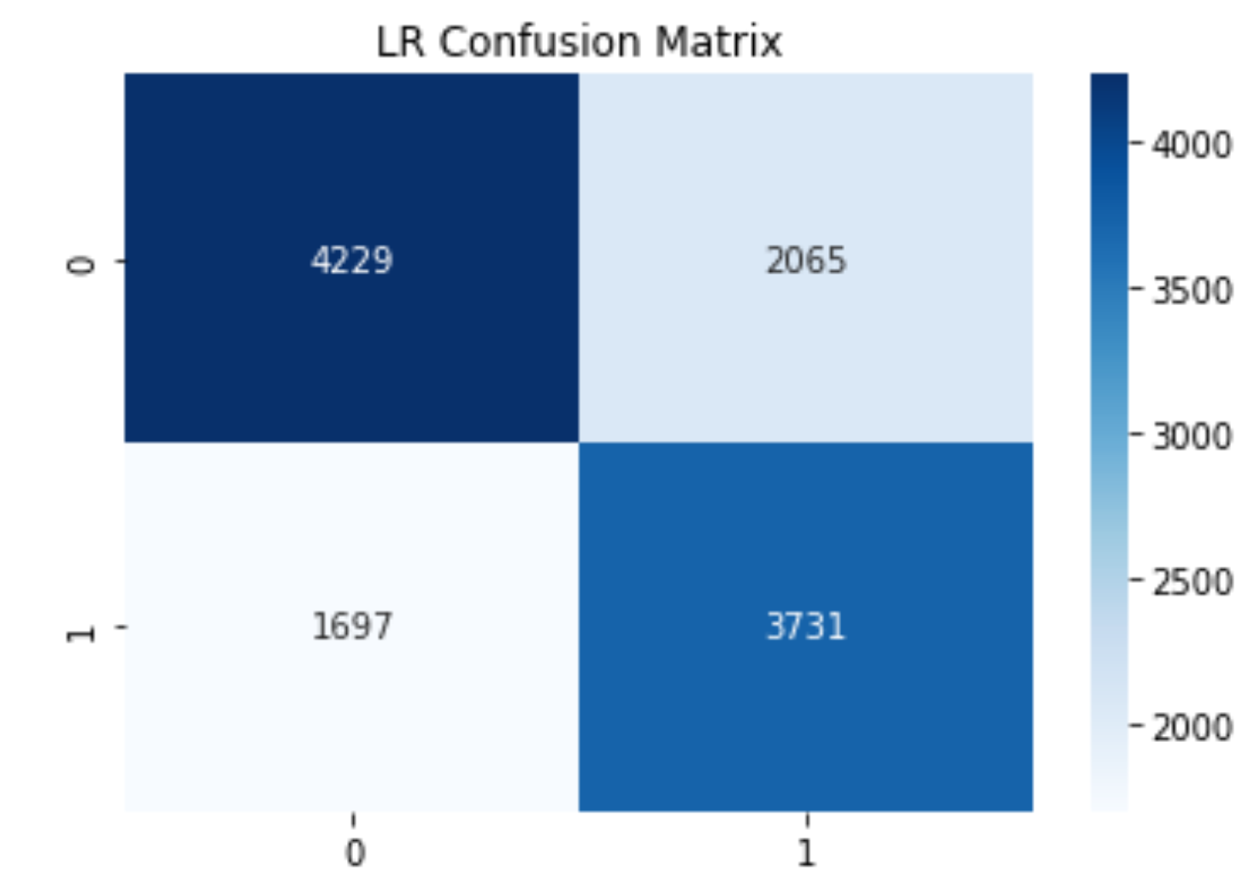
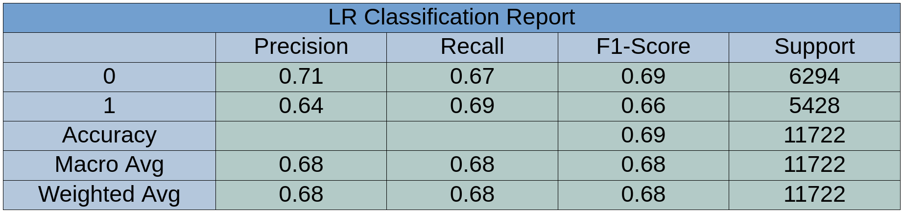
Results (cont.)
Logistic Regression Results:
F1-Score was ~68%
Substantially worst performance than Random Forest Classifier.
Figure 12: Logistic Regression Confusion Matrix
Figure 13: Logistic Regression Classification Report
Notes:
The results from the logistic regression classifier are shown in figures 12 and 13. True negative of 4229 versus it’s False negative of 1697 gave us an accuracy score of 71%. While True positive was 3731 with a false positive of 2065 yielded an accuracy of 64%. Precision, Recall and F1-Score averaged out to be approximately 68% which is substantially lower than what we scored for the random forest classifier.

Slide 20
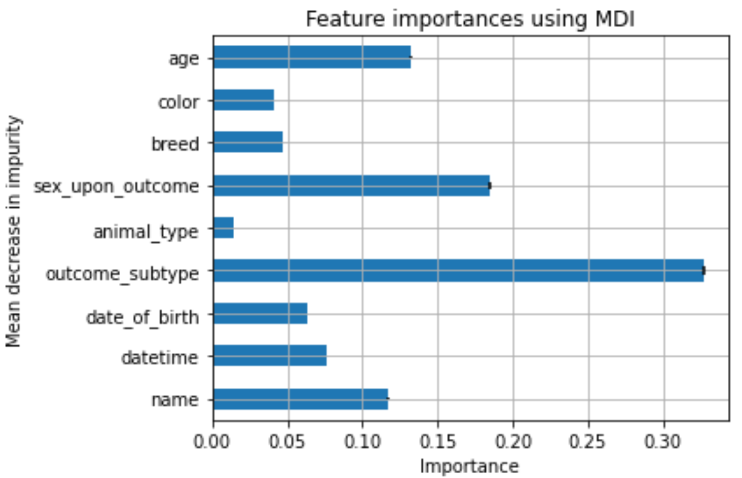
Results (cont.)
Random Forest Feature Importance:
1st : Outcome Subtype
2nd : Sex upon outcome
3rd : Age of Animal
Figure 14: Random Forest Feature Importance’s
Notes:
Comparing the results from the two classification algorithms it was determined to settle with the random forest classification.
Figure 14 visually displays the associated weights for the various features that the random forest model perceives.
The most important predictor in predicting the outcome seemed to be the outcome subtype which consists of variables such as behavior, in foster, aggressive, suffering, and etc.
Second to outcome subtype was sex upon outcome and next was age of the animal which is consistent with the idea that younger animals tend to be adopted more easily. This is the case due to senior pets, even those that are a few years old normally languish in shelters because people prefer a younger pet (Brown, 2020).

Slide 21
Conclusion
Serve to help further studies related to animal adoption
Worthwhile to confirm model with a different data set
Explore the model further to see where the thresholds are during the decision making process.
Notes:
In conclusion the results were promising and could be used by the shelter to help narrow down which animals would have difficulty being adopted and they could make changes to the resources spent.
With this initial study set, our model could be used as a baseline to look into other variables such as how long an animal is kept in shelter.
While the high score that the random forest classifier achieved was very promising, it’s not clear where the decision thresholds are without extracting all the trees generated by the algorithm and analyzing them together.
An attempt was made to reduce the total estimators and maximum depth, but performance of the model drastically suffered to where it performed on part or worse than the logistic regression model. Another improvement that could be made to the existing model would be to creating filter categories for some of the features that have large amounts of unique variables such as color or breed of an animal.
Improvement to understanding model is something worth investigating in the next iteration.

Slide 22
Thank You!
Notes:
The results that we’ve concluded to can be used by the shelter to help narrow down which animals would have difficulty being adopted and make changes to the resources spent.
With this initial study set, our model could be used as a baseline to look into other variables such as how long an animal is kept in shelter, intake age, and even outcome age.
While the high score that the random forest classifier achieved was very promising, it’s not clear where the decision thresholds are without extracting all the trees generated by the algorithm and analyzing them together.
An attempt was made to reduce the total estimators and maximum depth, but performance of the model drastically suffered to where it performed on part or worst than the logistic regression model. Another improvement that could be made to the existing model would be to creating filter categories for some of the features that have large amounts of unique variables such as color or breed of an animal.
While the color featured displayed over 500 unique values, the breed feature had over 2,000 varying breeds. Creating a comprehensive filter function would have taken more time allotted but may serve to help improve the consistency of the model.

Slide 23
References
Andrews, A. (2018, October 31). How Data Science Can Be Used to Improve Animal Shelter Outcomes. https://www.switchup.org/blog/how-data-science-can-be-used-to-improve-animal-shelter-outcomes
ASPCA. (2017, March 10). ASPCA Releases New Data Showing Remarkable Progress for Homeless Dogs & Cats. ASPCA. https://www.aspca.org/about-us/press-releases/aspca-releases-new-data-showing-remarkable-progress-homeless-dogs-cats
Bradley, J., & Rajendran, S. (2021). Increasing adoption rates at animal shelters: A two-phase approach to predict length of stay and optimal shelter allocation. BMC Veterinary Research, 17(1), 70. https://doi.org/10.1186/s12917-020-02728-2
City of Austin, Texas. (2021). Austin Animal Center Outcomes: Austin Animal Center Outcomes [Application/xml]. City of Austin, Texas Open Data. https://data.austintexas.gov/d/9t4d-g238
Notes:
Alexis

Slide 24
References
Lepper, M., Kass, P. H., & Hart, L. A. (2002). Prediction of adoption versus euthanasia among dogs and cats in a California animal shelter. Journal of Applied Animal Welfare Science: JAAWS, 5(1), 29–42. https://doi.org/10.1207/S15327604JAWS0501_3
Muñoz, A. (2019, May 15). Why the animal shelter population soars during summer months. Miami’s Community News. https://communitynewspapers.com/doraltribune/why-the-animal-shelter-population-soars-during-summer-months/
Riggio, C. (2019, November 3). What’s the deal with Accuracy, Precision, Recall and F1? Medium. https://towardsdatascience.com/whats-the-deal-with-accuracy-precision-recall-and-f1-f5d8b4db1021
Sencer. (2017, May 24). Do No-Kill Shelters Really Benefit Animals? KQED. https://www.kqed.org/education/499450/do-no-kill-shelters-really-benefit-animals
Notes:
Alexis

Slide 25
References
Andrews, A. (2018, October 31). How Data Science Can Be Used to Improve Animal Shelter Outcomes. https://www.switchup.org/blog/how-data-science-can-be-used-to-improve-animal-shelter-outcomes
ASPCA. (2017, March 10). ASPCA Releases New Data Showing Remarkable Progress for Homeless Dogs & Cats. ASPCA. https://www.aspca.org/about-us/press-releases/aspca-releases-new-data-showing-remarkable-progress-homeless-dogs-cats
Bradley, J., & Rajendran, S. (2021). Increasing adoption rates at animal shelters: A two-phase approach to predict length of stay and optimal shelter allocation. BMC Veterinary Research, 17(1), 70. https://doi.org/10.1186/s12917-020-02728-2
City of Austin, Texas. (2021). Austin Animal Center Outcomes: Austin Animal Center Outcomes [Application/xml]. City of Austin, Texas Open Data. https://data.austintexas.gov/d/9t4d-g238
Notes:
Alexis

